Slide 1

Dept. Of Telecommunication
Solar piezo hybrid power charging system
Project guide:
Prof. Chanda V Reddy
Team Members:
Ankitha A Jain 1KS13TE004
Chetan K C 1KS13TE012
Ranjitha S 1KS13TE035
Thahir Saquib Khan 1KS13TE048

Slide 2
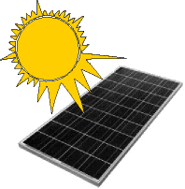
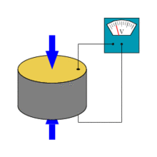
introduction
+
=
Solar piezo hybrid system
Solar energy
Piezo energy

Slide 3
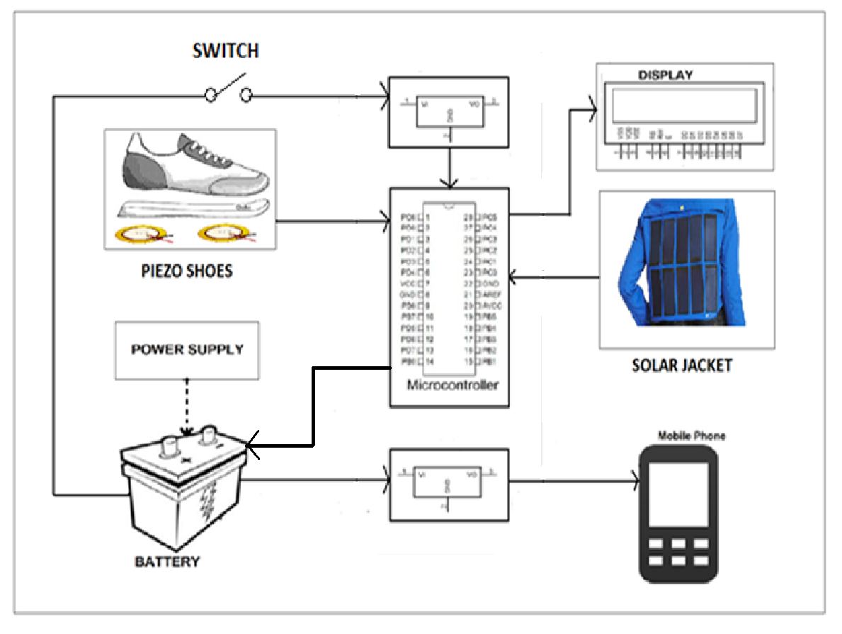
Block diagram of proposed model

Slide 4
Hardware description
Microcontroller (Atmega 328 family)
Solar panel
Piezoelectric sensors
Voltage regulator
LCD
12V rechargeable battery
Battery level indicator

Slide 5
(1) MICROCONTROLLER:-
It is a smaller computer
Has on-chip RAM, ROM, I/O ports…
CPU
RAM
ROM
A single chip
Serial COM Port
Microcontroller
I/O Port
Timer

Slide 6
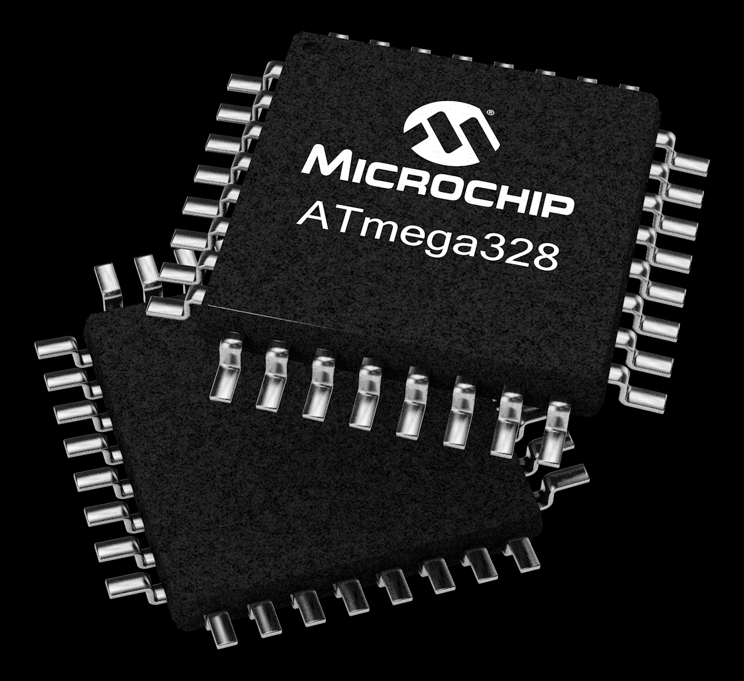
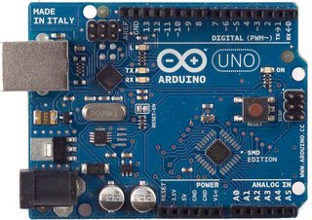
FEATURES OF ATMEGA328:
Advanced RISC Architecture
131 Powerful Instructions
32 x 8 General Purpose Working Registers
Flash Program Memory: 32 kbytes
EEPROM Data Memory: 1 kbytes
SRAM Data Memory: 2 kbytes
I/O Pins: 23
Timers: Two 8-bit / One 16-bit
A/D Converter: 10-bit Six Channel
PWM: Six Channels

Slide 7
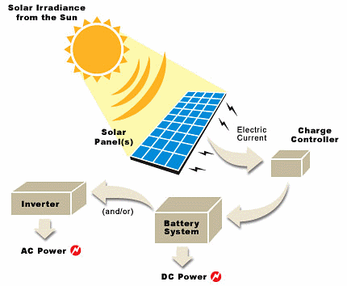

(2) SOLAR PANEL:-
Photovoltaic cells
Excited Electrons- generate electricity

Slide 8
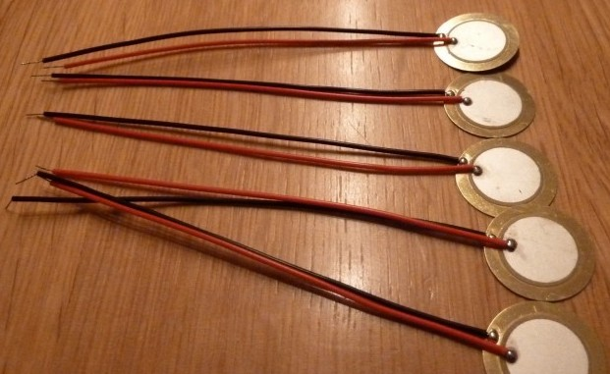
(3) Piezoelectric pressure sensor:-
Piezoelectric sensors convert stress into an electric potential and vice versa.
Sensors based on this technology are used to measure varying pressures.

Slide 9
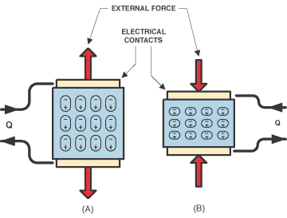
Piezoelectricity:
“Piezoelectricity” = electricity resulting from pressure.
Piezoelectricity – accumulated electric charge in solid materials - respond to applied mechanical stress.

Slide 10
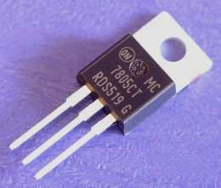
(4) Voltage regulator:-
Maintains output voltage at a constant value.
Provides +5V regulated power supply.
3 pins-
Input
Ground
Output

Slide 11
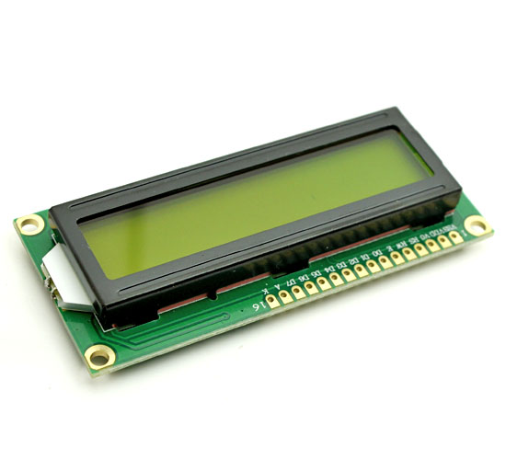
(5) LCD:-
16 X 2 LCD
16 pins
Eight(8) data pins D0-D7
Vcc (Apply +5 volt here)
Gnd (Ground this pin)
RS (Register select)
RW (read - write)
En (Enable)
V0 (Set LCD contrast)
A (Anode)
K (Cathode)

Slide 12
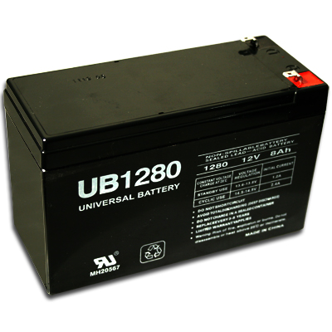
(6) Battery:-
Lead acid 12V battery
Rechargeable

Slide 13
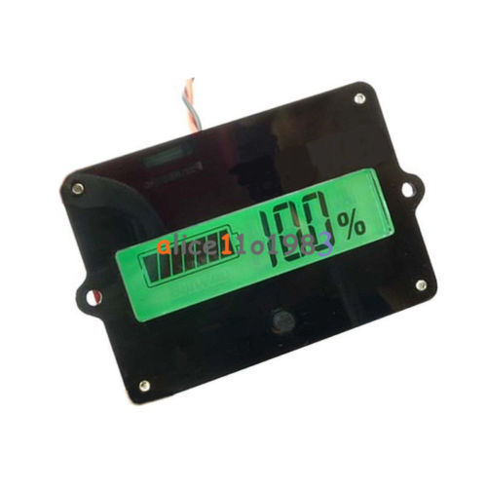
(7) BATTERY LEVEL INDICATOR
Input voltage : 8-48V
Input current : 5-10mA
Input power consumption : 200-700mW
Fit for Battery Type : lead-acid battery and Lithium battery

Slide 14
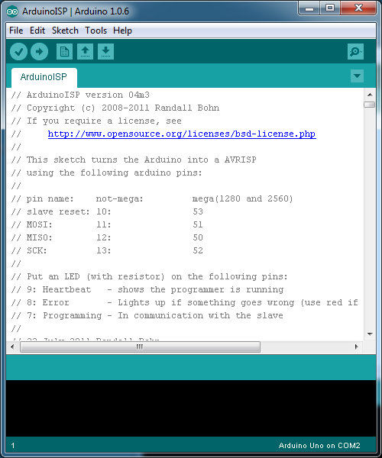
SOFTWARE DESCRIPTION
Arduino Software (IDE):-
Contains text editor, message area, text console, toolbar and a series of menu
Sketches- file extension .ino

Slide 15
INTERFACING

Slide 16
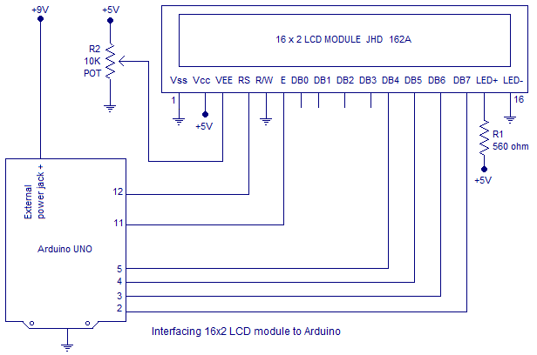
Interfacing LCD with Arduino

Slide 19
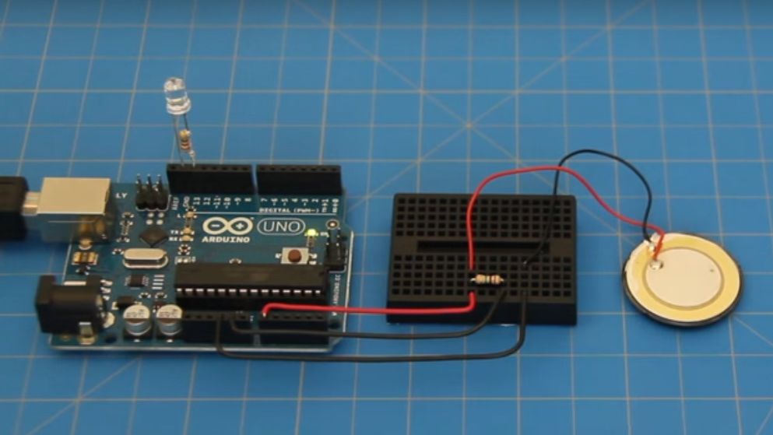
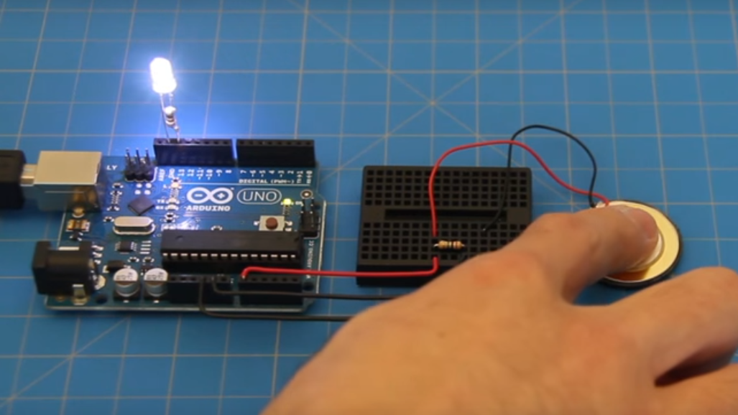
Interfacing piezo sensor with Arduino

Slide 20
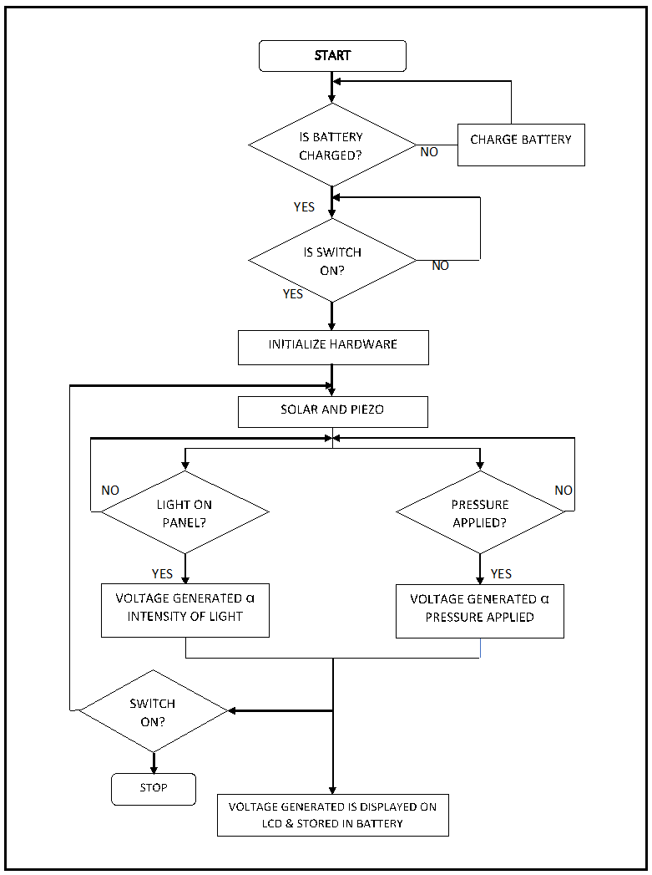
Flowchart

Slide 21
Schematic Diagram

Slide 22
applications

Slide 23

People powered charging system at malls, office, etc.

Slide 24
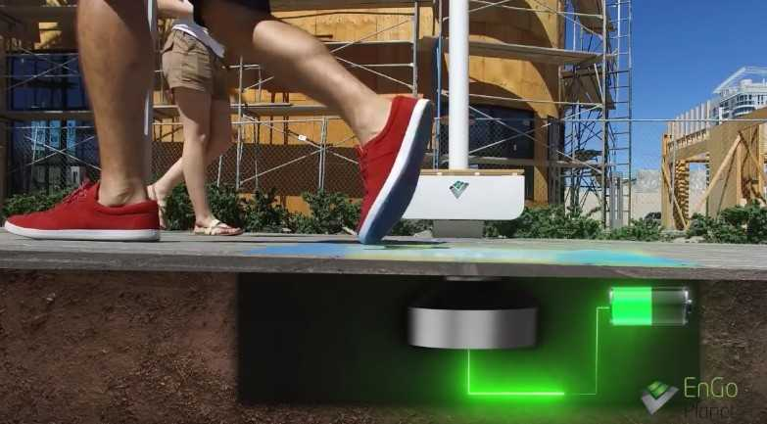
Power generating side walks

Slide 25
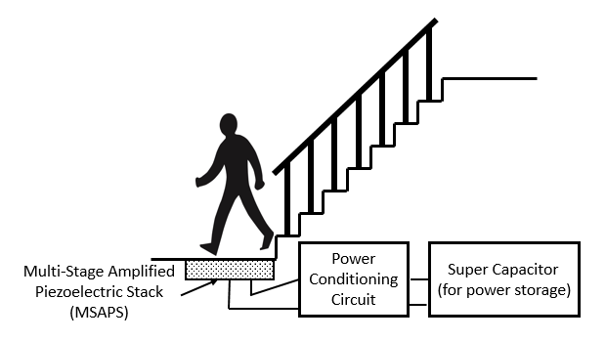

Power generating staircase

Slide 26
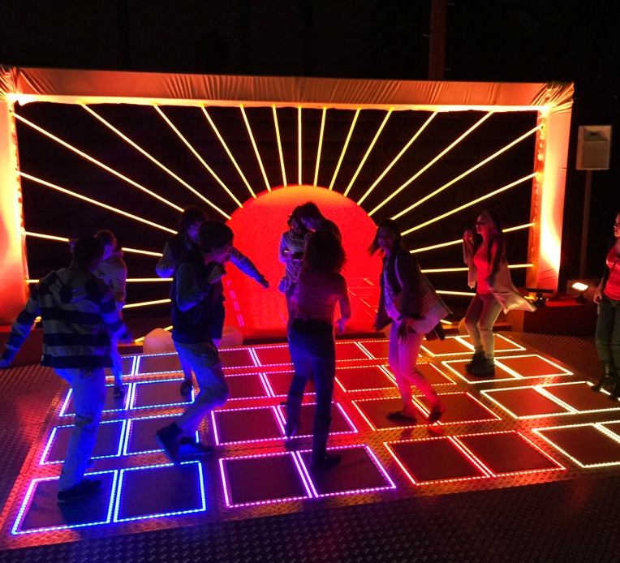
Floor mats and people powered dance clubs

Slide 27
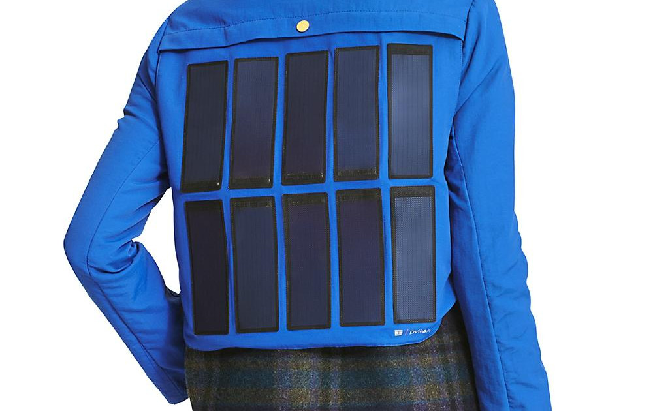
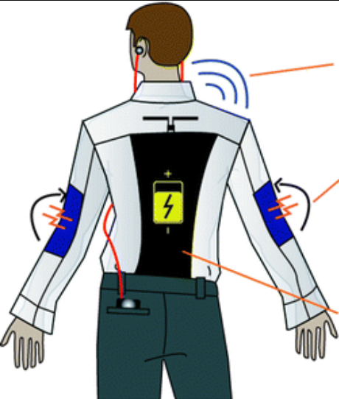
Solar jacket

Slide 28
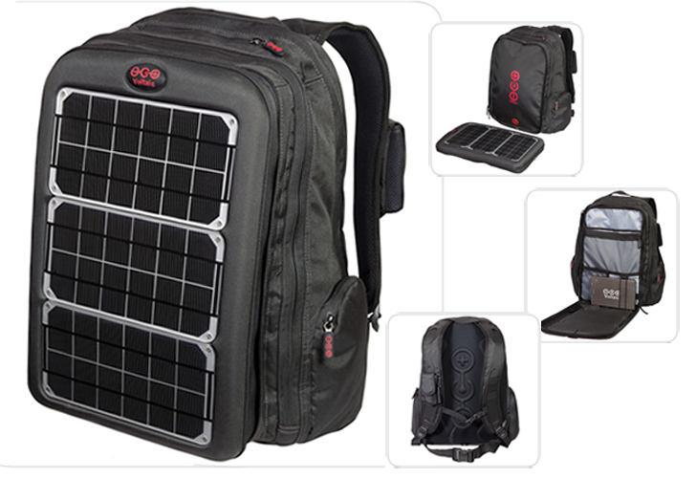

Solar bags

Slide 29
limitations
Piezo crystal is prone to crack if over stressed
Solar panel may get affected by long use at high temperatures
Cannot be used for truly statistic measurements
High principle investment

Slide 30
Experimental results
SOLAR SOURCE
Weather | Voltage | Duration | Battery charged
SUNNY | 18V-20V | 3 hours | 25%
NORMAL | 10V-13V | 3 hours | < 25%
CLOUDY | 5V-8V | 3 hours | < 25%

Slide 31
PIEZO SOURCE
Speed (kmph) | Duration | Battery charged
10 | 1 hour | 25%
20 | 1 hour | < 25%
30 | 1.5 hours | < 25%

Slide 32
DRAINED BATTERY CHARGED FOR 5 MINS THROUGH POWER SUPPLY
Board ON (with LCD) | Board ON
6.63 min | 27.15 min

Slide 33
Conclusion
The project “solar piezo hybrid power charging system” is successfully tested and implemented which is the best economical, affordable energy solution to common people.
This can be used for many applications in rural areas where power availability is less or totally absence.
Newer technologies could make a very reliable power generation.

Slide 34
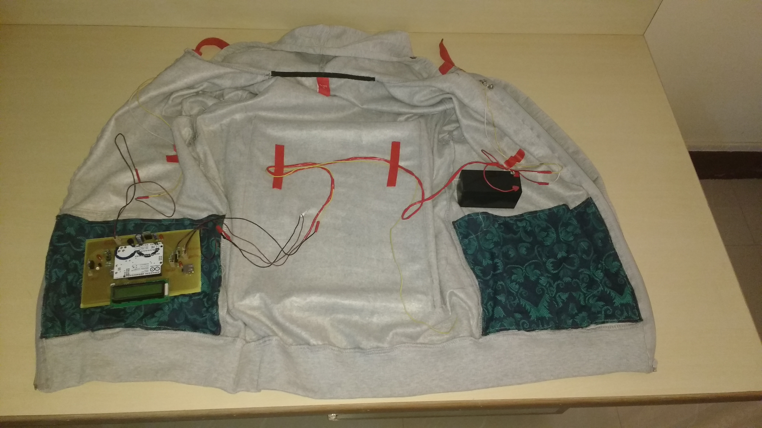
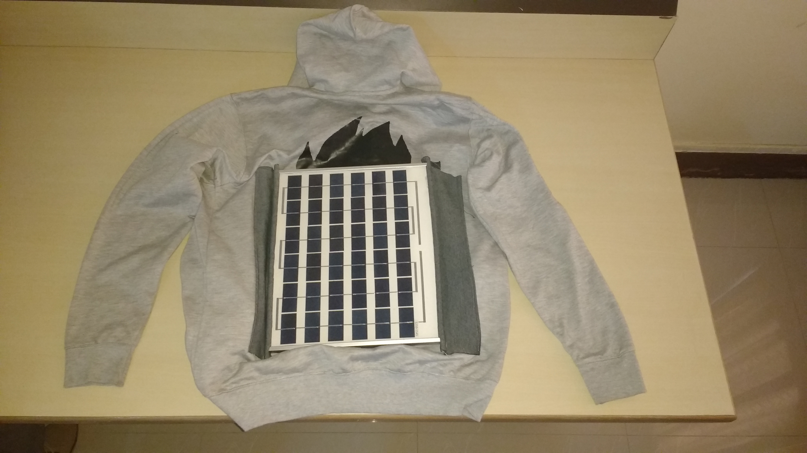
Solar jacket

Slide 35
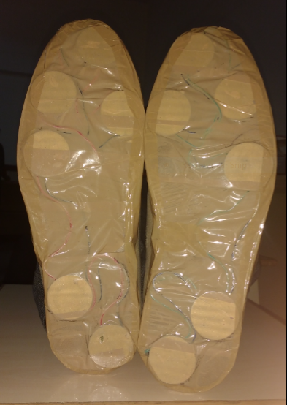
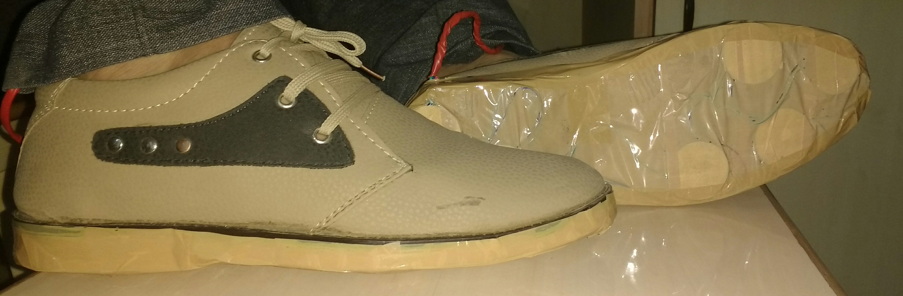
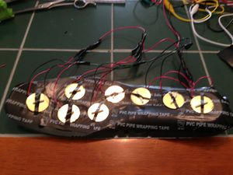
Piezo shoes

Slide 36
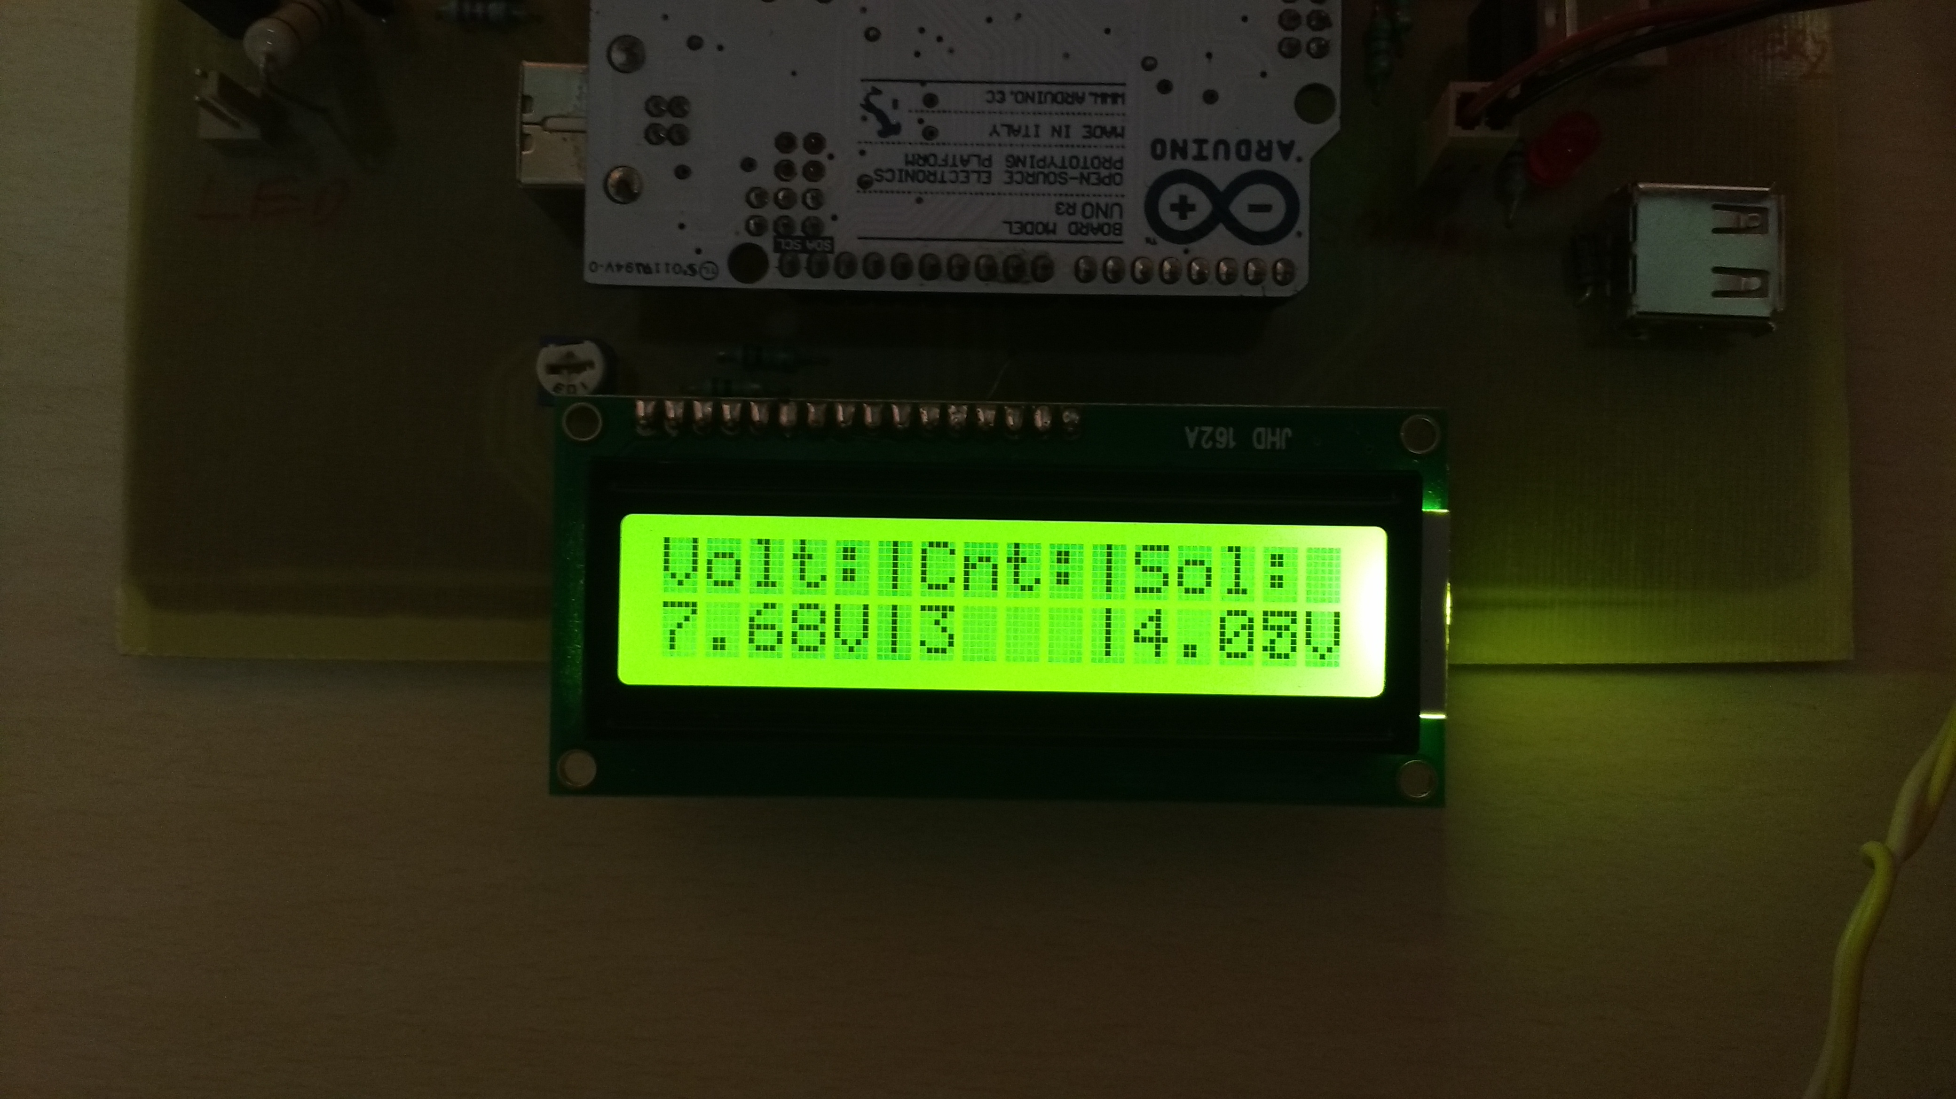
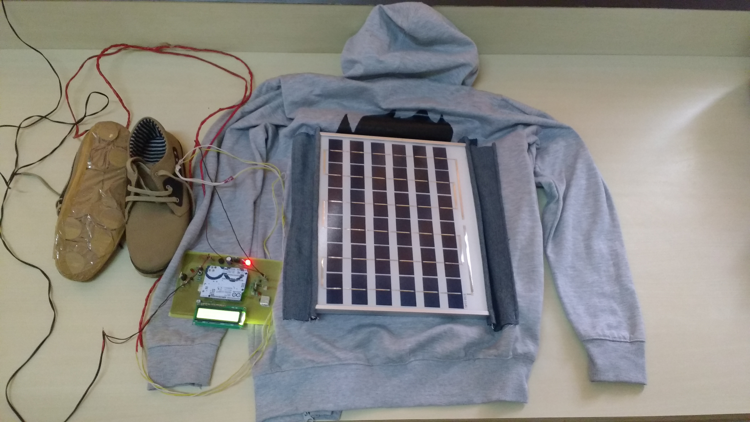
overview

Slide 37
Future scope
Flexible solar strips can be used
Battery size can be made compatible and more efficient batteries can be used

Slide 38
VIDEO CLIP

Slide 39
THANK YOU

